Slide 1
Hotel Listing Analysis

Slide 2
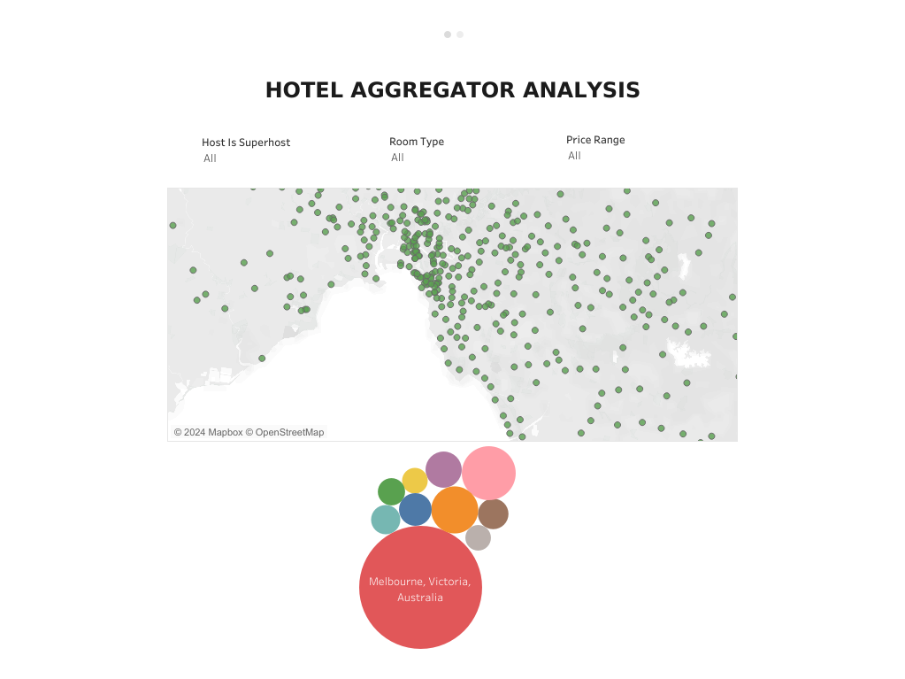

Slide 3
